Slide 1
Automation Testing on Best Buy -E commerce Web Application

Slide 2
Presented By
Md Monjurul Hasan Razu - 193002180
Pranto Dutta - 201002109
Dept of CSE,
Green University of Bangladesh

Slide 3
Table OF CONTENT
Introduction
Objectives
Testing Goals
Framework and Tools
Key Test Cases
Execution and Results
Challenges and Solutions
Conclusion
1

Slide 4
Introduction
Best Buy
Leading e-commerce Web Application
Selenium
A powerful open-source tool for automating web application testing.
Key Features
Supports multiple browsers.
Integrates with various programming languages like Java, Python etc.
Enables functional and regression testing.
Significance of Testing
Ensuring the platform's functionality, reliability, and user experience.
Why Automation?
Faster, more accurate, and scalable compared to manual testing.
2

Slide 5
objectives
Automate Unit tests, regression tests and functional tests.
Reduce testing time while improving accuracy and consistency.
Create reusable, modular scripts for adaptability with future changes.
3

Slide 6
Testing Goals
Validate
Search functionality.
Shopping cart and checkout processes.
Navigation and user interaction elements.
Ensure cross-browser compatibility.
Provide detailed reports for stakeholders.
4

Slide 7
Framework & Tools
Framework
TestNG for test management.
POM (Page Object Model) for reusability.
Tools Used
Selenium WebDriver for automation.
Maven for dependency management.
5

Slide 8
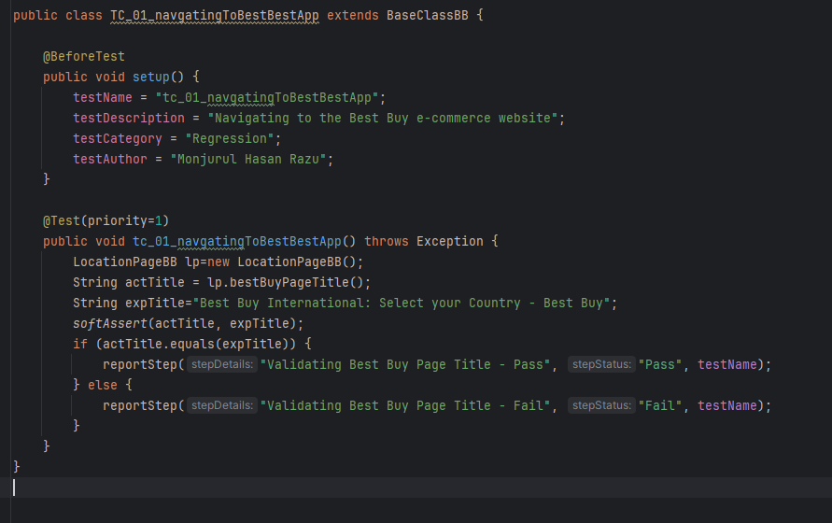
test cases
Test Case 01
6

Slide 9
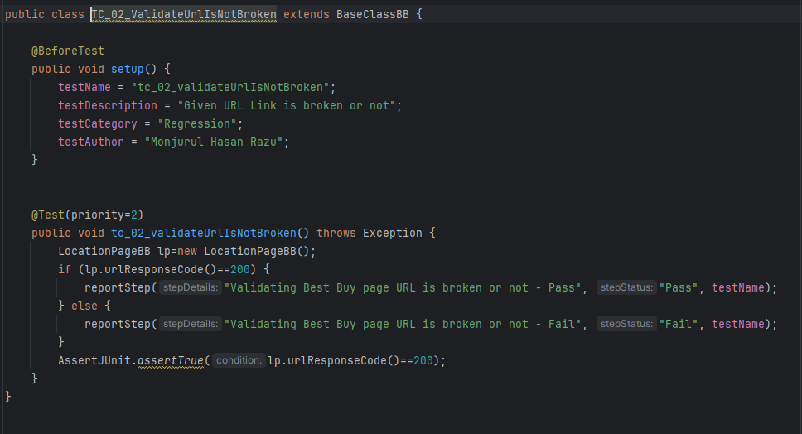
test cases
Test Case 02
7

Slide 10
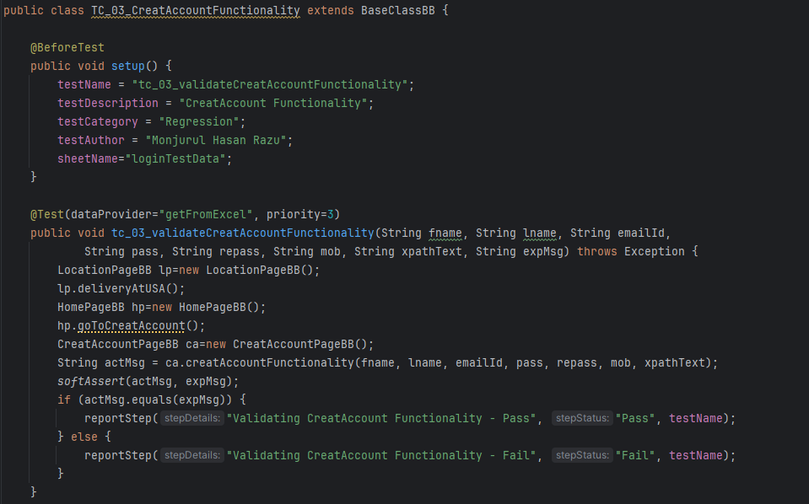
test cases
Test Case 03
8

Slide 11
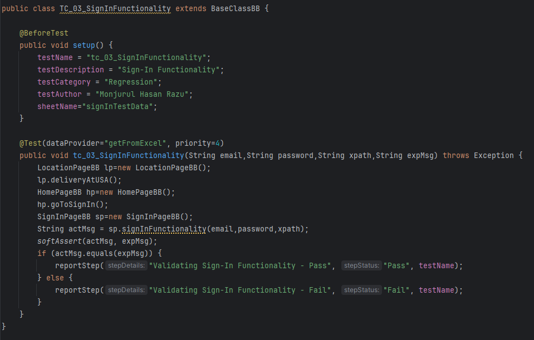
test cases
Test Case 04
9

Slide 12
Execution & Results
10

Slide 13
Challenges and Solutions
Challenges
Handling dynamic elements and synchronization issues.
Cross-browser inconsistencies.
Ensuring scalability and maintainability.
Solutions
Implemented robust explicit wait conditions.
Used browser-specific configurations.
Modularized scripts using POM for easy updates.
11

Slide 14
Conclusion
Selenium automation has improved testing efficiency and coverage for Best Buy’s e-commerce platform, ensuring faster feedback and better product quality. Expanding automation will further optimize testing.
12

Slide 15


